Slide 1
Week 1
CUA REU 2024

Slide 2
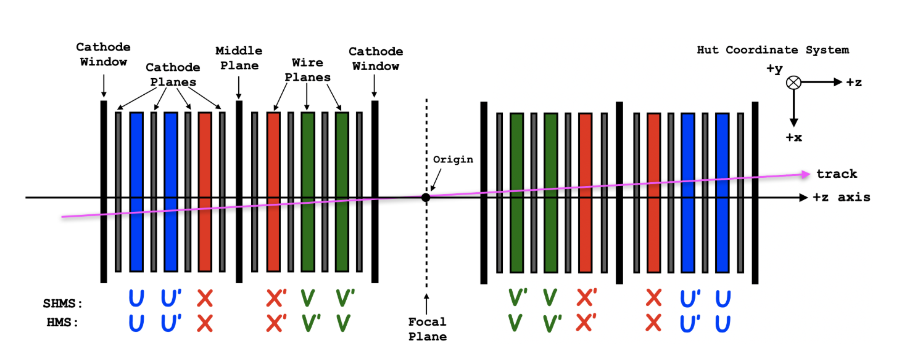
Project: Calibration of Drift Chambers
Abstract
The experiments take place in JLab Hall C which consists of a pair of magnetic spectrometers designed to calculate high-precision cross section measurements of electro-disintegrating deuteron particles. The objective of the calibration is to produce a time-to-distance map in order to determine the position path of the particle from the measured drift times.
This week’s progress:
Reading excerpts from Dr. Yero’s thesis
Downloaded CERN ROOT
Finished setting up and acquiring my JLab Computer account to start working remotely on my project
Learning C++
Side-view of the Drift Chambers (DC) and it’s components. (From Dr. Yero’s Thesis)

Slide 3
Next week…
Now that I have a JLab Computer account, I have access to raw data files
Use deut_offline_replay (a cloned repository from Dr. Yero’s github) to convert the raw data files into root files
Combine all root files into one and then using ROOT to analyze the data
Create histograms of the data and analyze

